Slide 1
Automated Intelligence
for Small Businesses

Slide 2
The Problem
Small business owners on third party marketplaces have $1 trillion in annual sales. However, they still rely on informed guesswork to make crucial product decisions.
Current solutions are either prohibitively expensive or require too much technical expertise.
There is a better way

Slide 3
The Solution
Whatify provides automated intelligence for small business. We use “A/B testing 2.0” to constantly optimize photos, prices and more for third party sellers on e-commerce platforms.
A/B Testing 2.0 pools data across tens of thousands of experiments to deliver valuable results in weeks rather than years.
This allows us to communicate our value. We tell you dollars of value added per month (existing A/B testing services say, “70% chance image A is better” because their value added is peanuts unless you test for years)

Slide 4
Our Team

Slide 5


The Team
Professor
MBA
Jason Abaluck, Founder
Associate Professor
of Economics & Business at Yale
PhD, MIT and AB, Harvard
Jake Phillips, CEO
MBA, Yale ’17, Brown ’10
NYC Gov data systems builder
Founder of rikers island nonprofit
Developed models to efficiently combine the results of many separate A/B tests based on years of related research
Experience managing successful development projects

Slide 6
The Website

Slide 7
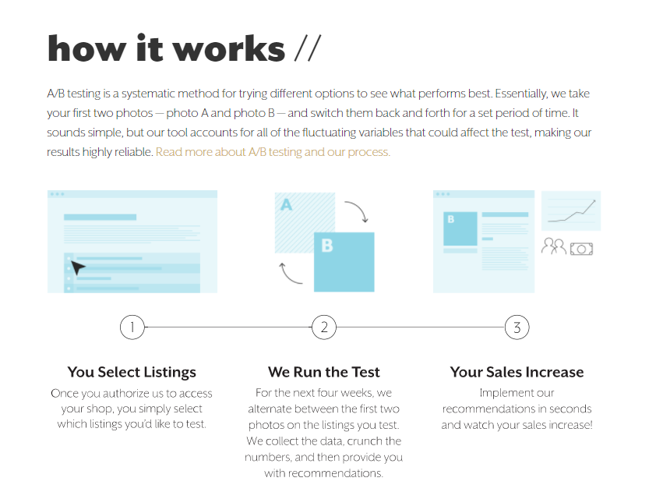

Home page

Slide 8
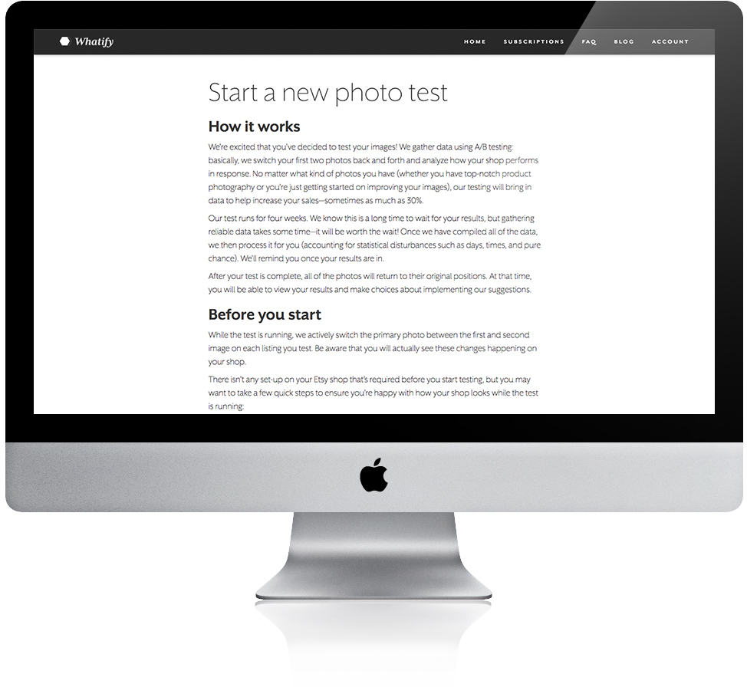
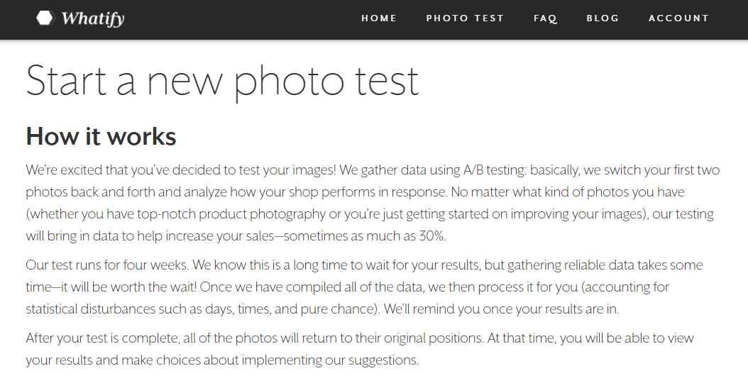
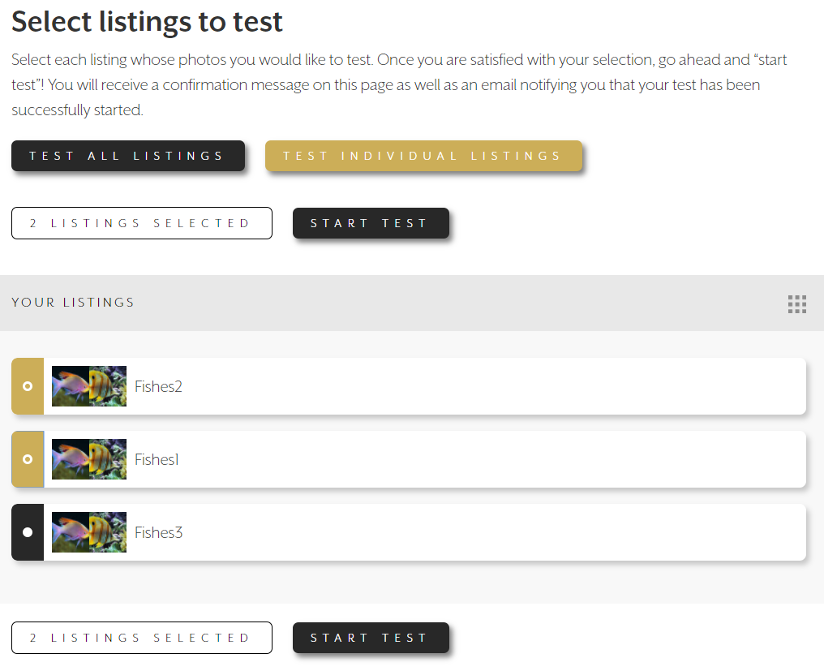
Creating your test

Slide 9
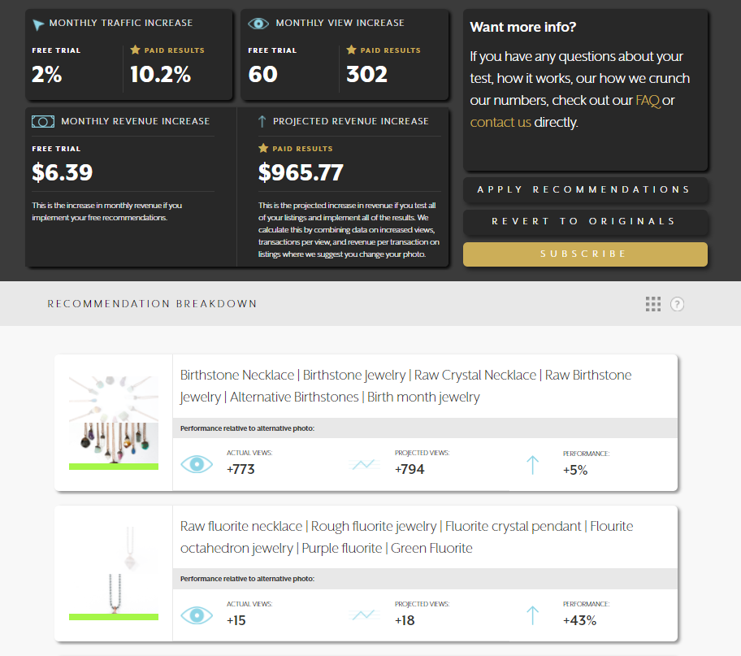
Your results
We provide a detailed analysis of the impact of our recommendations on individual products and on the business as a whole.
Our results concisely communicate the value that our service generates for our users’ businesses.
As a result, 10-15% of our free users are converting to paid subscribers.

Slide 10
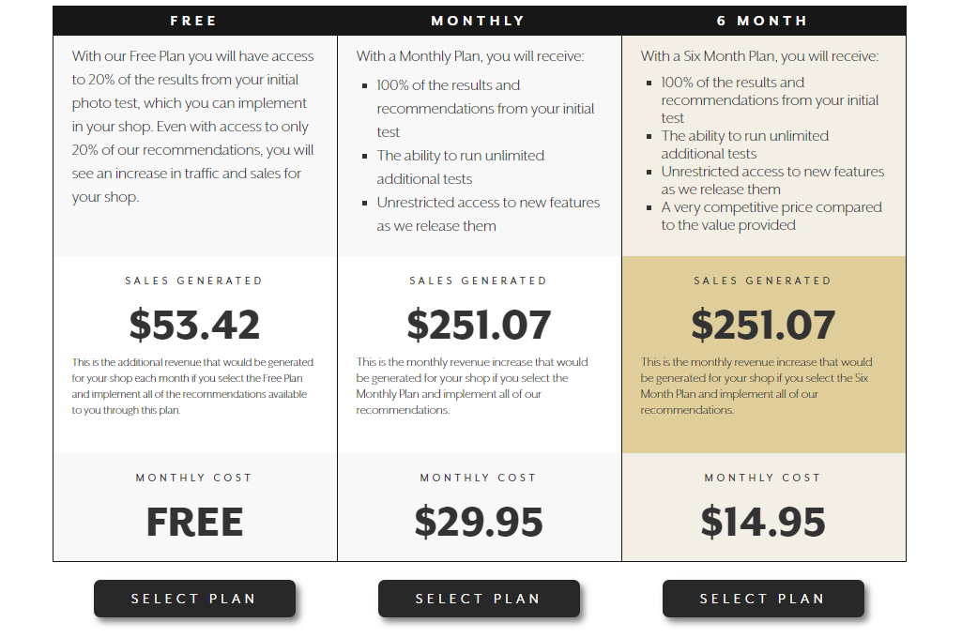
Your subscription
Subscription price individualized based upon value added to shop
Six Month Price = 5% of value generated, currently capped at $100/month

Slide 11
The Market
Market Opportunity

Slide 12
Market Opportunity
Sellers on Third Party Marketplaces
$1 trillion in annual sales by tens of millions of small business owners across marketplace platforms.
Our current product, A/B testing photos, increases revenue by 10% in one month. That will grow:
Currently adding price testing (keywords to come)
More data improves model
Can add targeting based on demographics
No one else offers automatic A/B testing, let alone what we call “A/B testing 2.0”

Slide 13
Business Approach

Slide 14
Revenue Model
We sell directly to third party sellers on marketplace app stores.
Currently on Etsy, but launching on Shopify in April (and Woo-Commerce with sufficient funding)
Working on direct partnerships with 3rd party platforms
SaaS model with a free trial
Start one test and receive 20% of your results for free. Subscribe to reveal the remainder of your results and run additional tests.
Subscription price individualized based upon value added to shop
Price = 5% of value generated. Currently no more than $100/month and no less than $5/month (but we’re experimenting!)

Slide 15
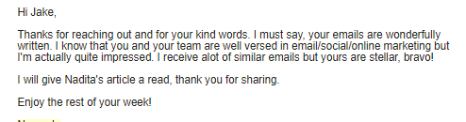
Traffic + Authorizations Since August
Good Marketing
Good Product

Slide 16
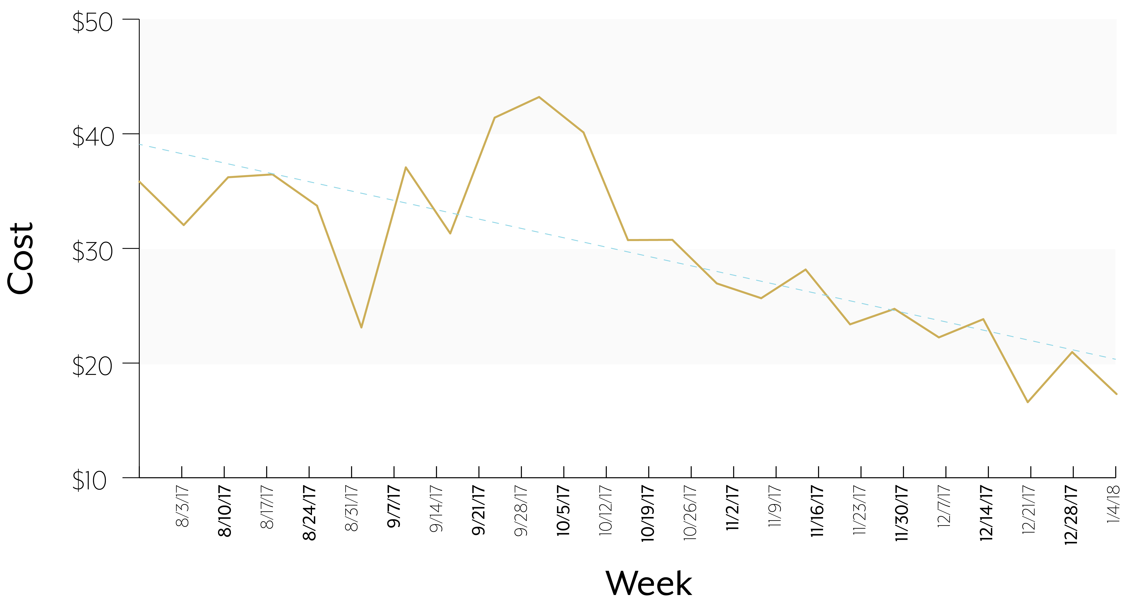
Cost per acquired user (free or paid)

Slide 17
Conversion and Retention Strategy
10 – 15% free trial → paid subscribers. This will only improve:
Higher value sellers convert at significantly higher rates. Shopify has more high value sellers than Etsy
Constantly testing and improving UX and website design to increase conversion rates
Retention
90% of paid subscribers sign up for 6 month subscription with automatic renewal (will know renewal rates soon)

Slide 18
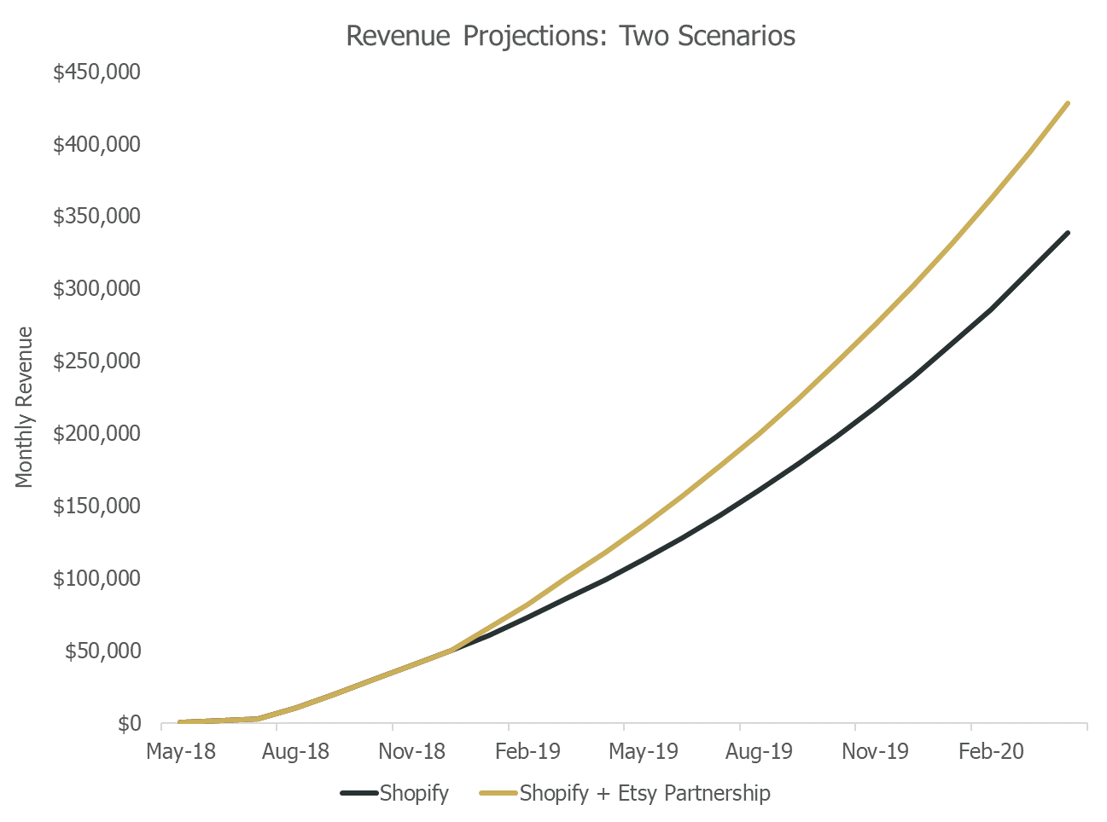
Revenue Projections
Shopify Revenue
Free product approaches 3% market penetration by year 3
Free:paid conversion increasing from 20% to 30% (currently 15% on Etsy but higher for larger shops and Shopify sellers are larger on avg)
10% Annual Churn
$60/month per subscriber
Several Shopify apps, such as Bold and Stitch Labs, have over 350k in monthly revenue
Etsy Expansion Revenue
Etsy partnership results in acquisition of 1.5%* of new and active Etsy sellers over next 48 months
20% annual churn
$15/month per subscriber
*based on email marketing conversion rates

Slide 19
Why you should invest
Large potential for growth in the medium term – realistic revenue projections could be $5 million annually on Shopify within 3 years, several times larger with Etsy and Shopify partnerships
Low overhead (~$15K-$20K per month, Jason works for free so this pays Jake and developers)
Many markets to expand into, enormous potential for long-term growth.
In the future, you will wake up in the morning, go to your closet, and your navy blue suit will be highlighted because wearing it will increase your chance of a successful meeting by 4%. These predictions will be powered by pooled, randomized experiments – hopefully using Whatify’s algorithms.

Slide 20

The Ask
We are asking for $500k, which will allow us to:
Finish Shopify integration, integrate with Amazon and Woocommerce
Expanded marketing to build our subscriber base on Shopify
Additional features such as keyword testing, analytics dashboard
Bring on full time CTO to oversee “modular” strategy (paying developers with experience with each API to port our product)

Slide 21
Thank you.

